Slide 1
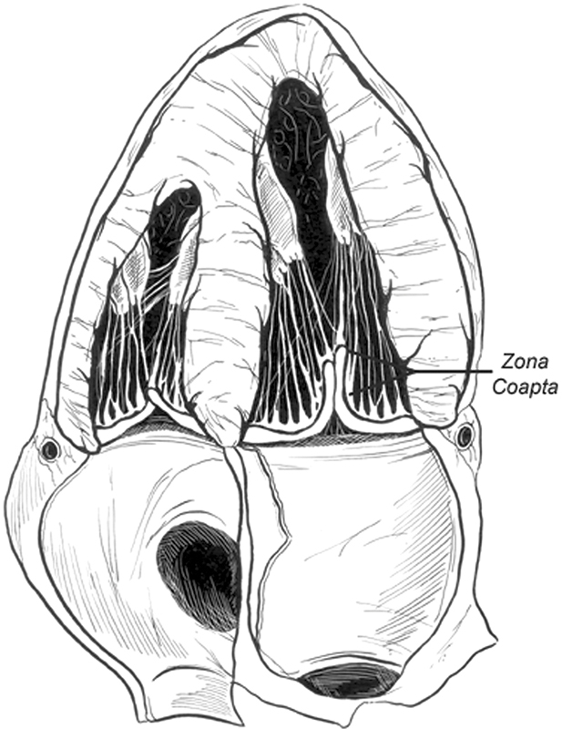
ECHOCARDIOGRAPHY IN MITRAL STENOSIS
Dr Ajay Nair

Slide 2
ETIOLOGY
RHEUMATIC HEART DISEASE
CONGENITAL M.S
DEGENRATIVE M.S
OTHERS

Slide 3
RHEUMATIC M.S
Commissural Fusion
Leaflet thickening
Chordal Thickening
Superimposed Calcification

Slide 4
DEGENERATIVE M.S
Annular Calcification
Rarely leaflet thickening and calcification at base

Slide 5
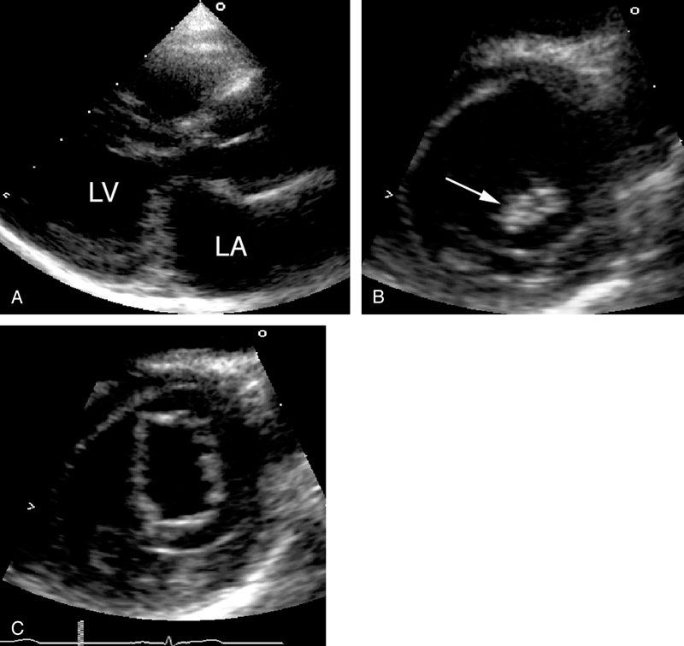
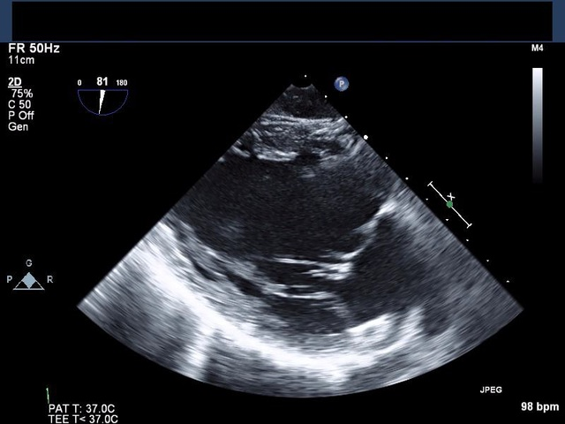
CONGENITAL M.S
Parachute Mitral Valve
Anomalous Mitral arcade
Double Orifice Mitral Valve

Slide 6
OTHERS
SLE,Carcinoid & Drug Induced
Leaflet thickening and Restriction are common here.
Commisures rarely fuse.

Slide 7
2-D ECHO
PSAX
Commisural Fusion
Differentiates Rheumatic from degenetrative M.S
Complete Fusion-Severe MS
Narrow Diastolic opening of M.V

Slide 8
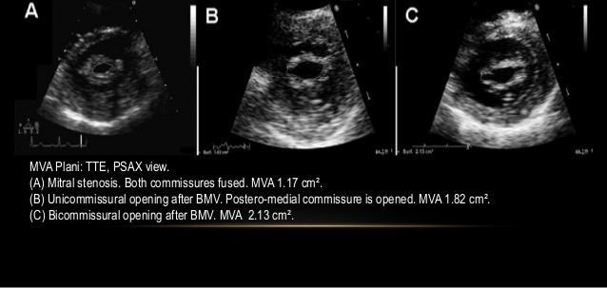

Slide 9
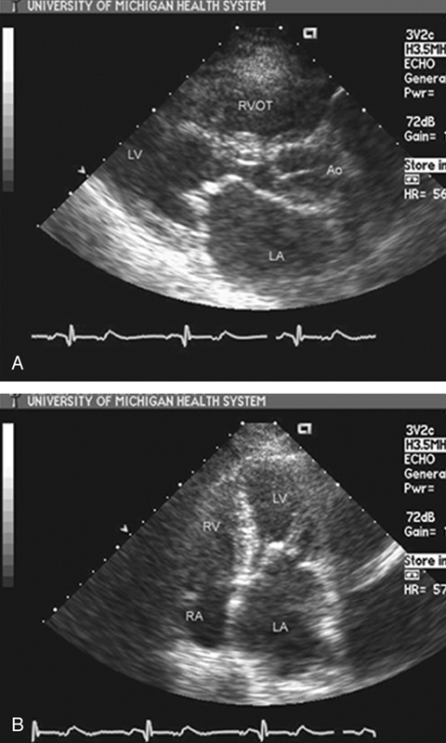
PLAX
Restricted Mobility
Early diastolic doming of AML-Restriction of tip motion
Leaflet Thickening

Slide 10
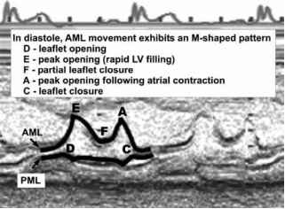
M-Mode Echo

Slide 11
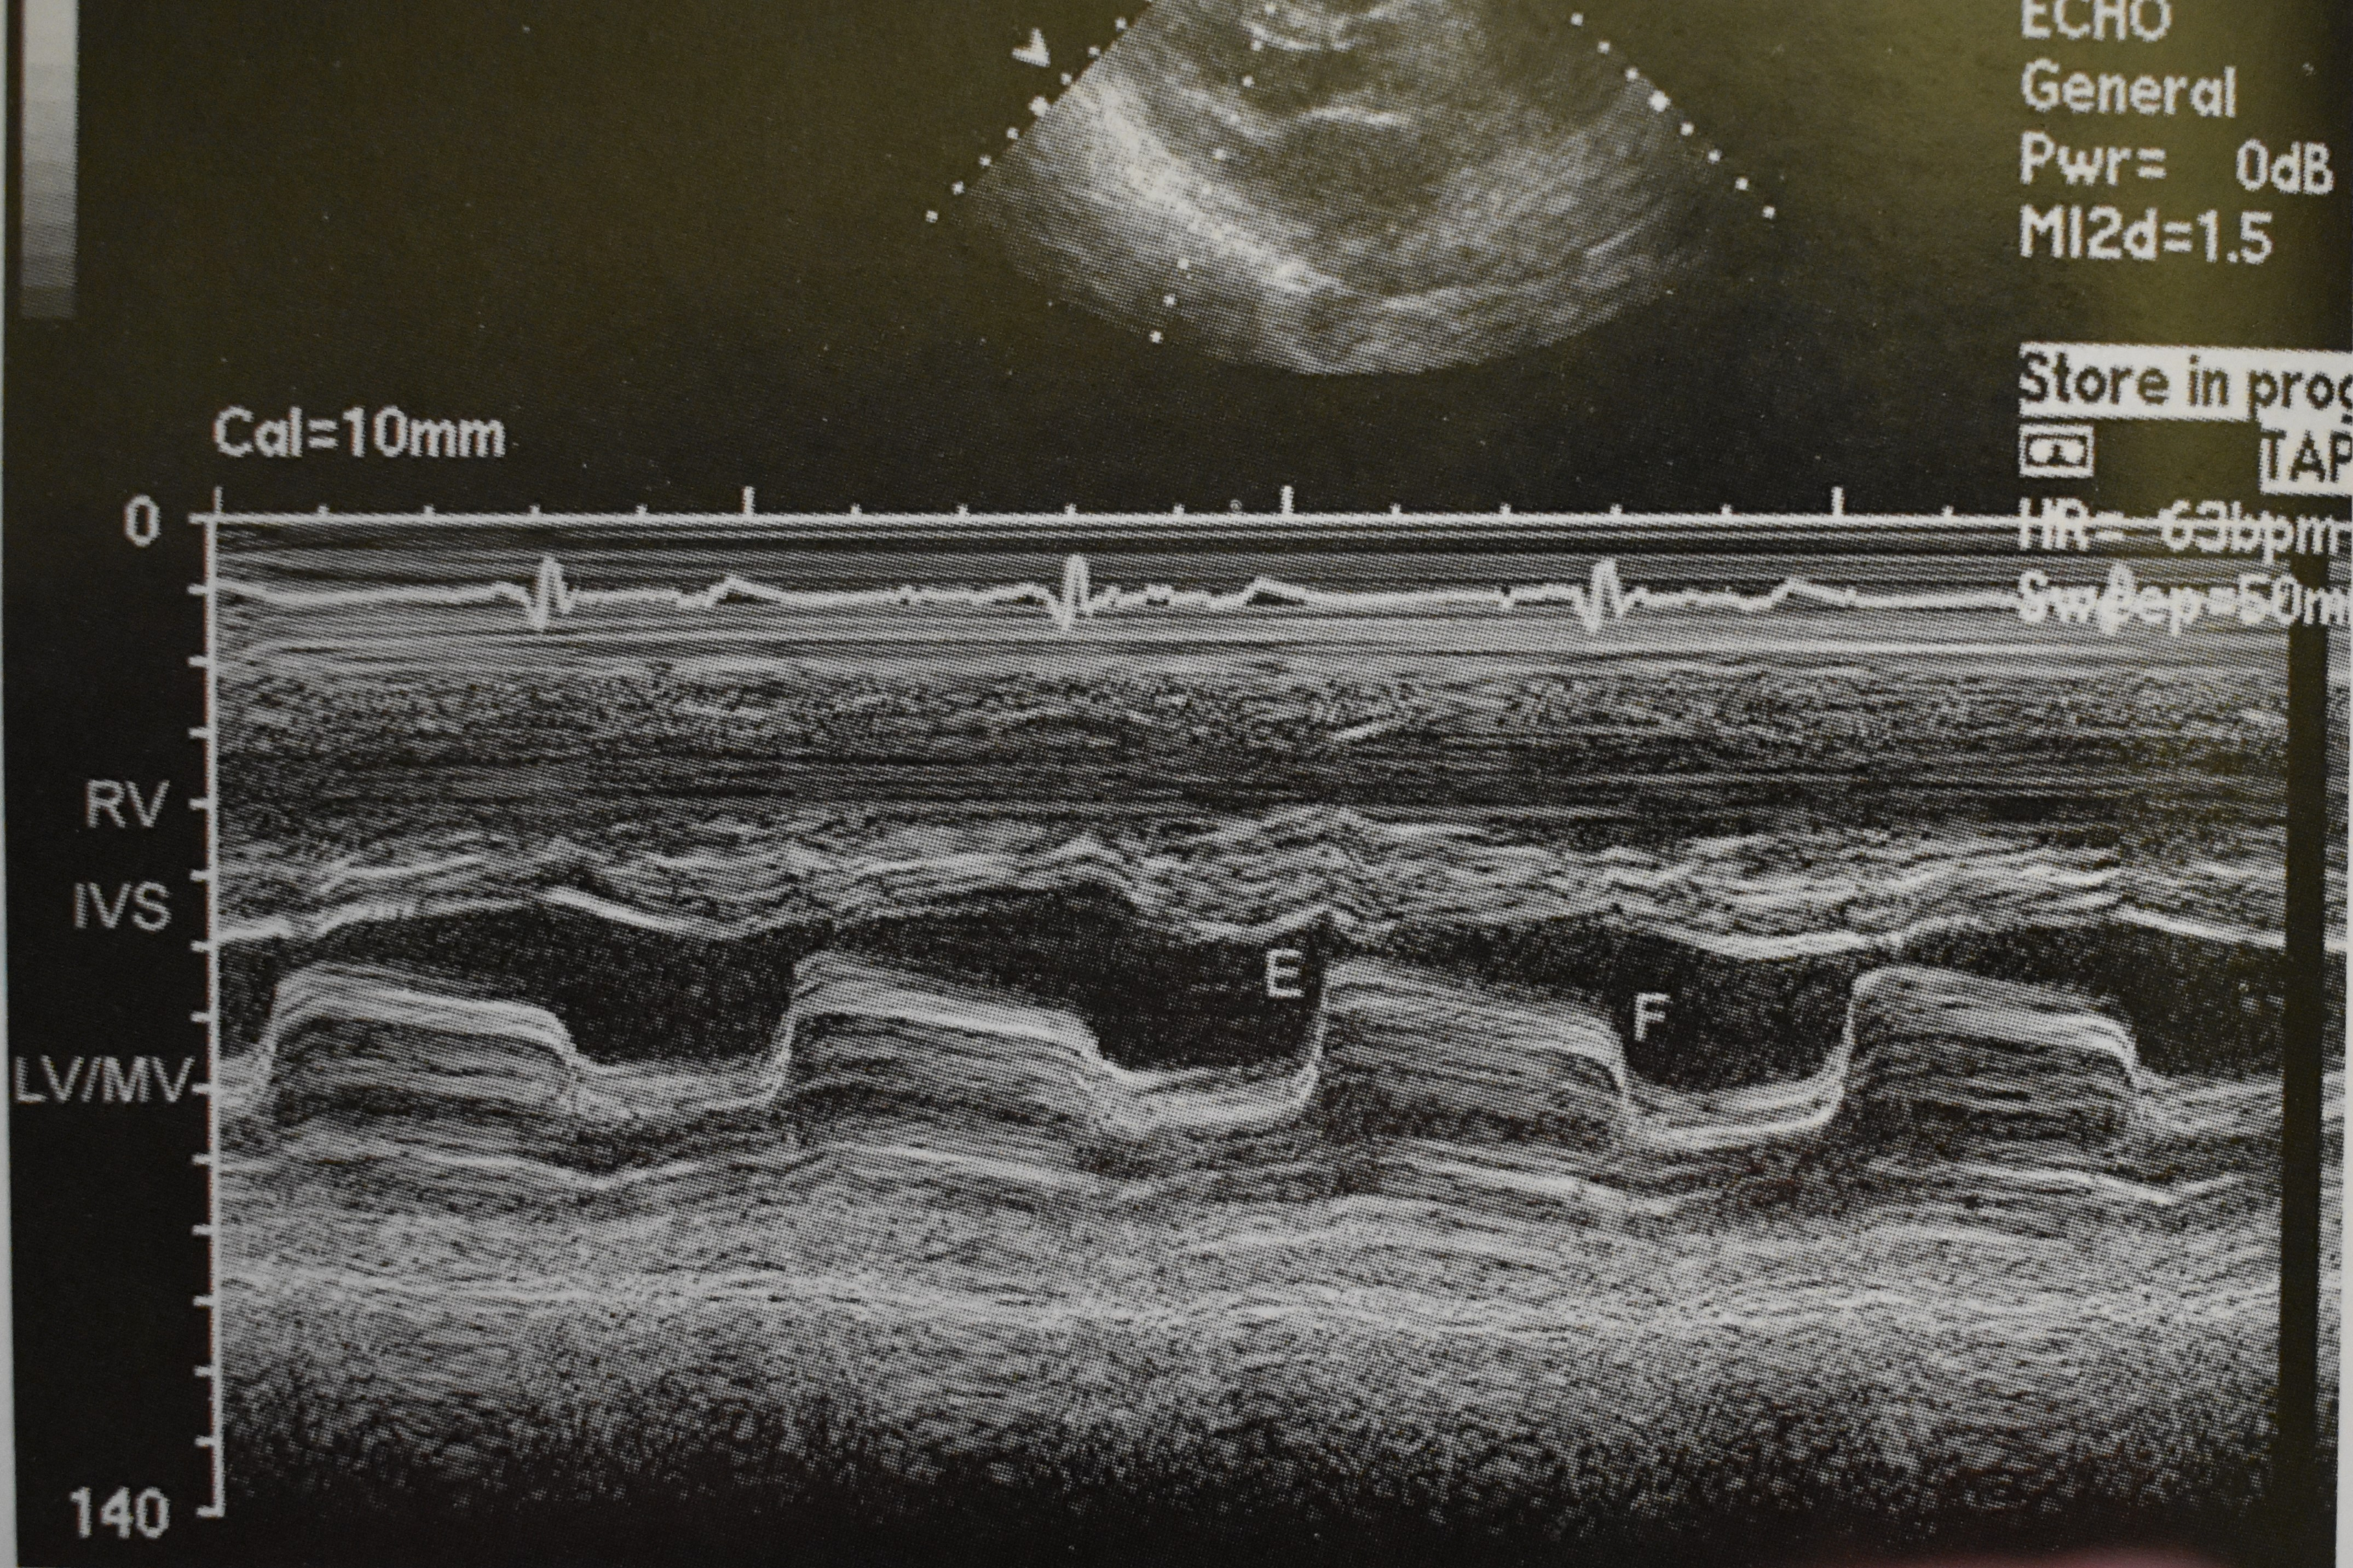
M-Mode Echo
Increased echogenicity
Decreased Excursion and leaflet separation
Decreased diastolic E-F Slope
Normal - > 60mm/sec
Severe MS- <10mm/sec

Slide 12
ASSESMENT OF SEVERITY IN MS
LEVEL 1 RECOMMENDATIONS
1.Pressure Gradient
2.MVA Planimetry
3.Pressure Half Time
LEVEL 2 RECOMMENDATIONS
1.Continuity equation
2.PISA Method
3.Stress Echocardiography

Slide 13
PRESSURE GRADIENT
Measured in Apical View
Continuous Wave is preferred. Aligned as parallel as possible to the anticipated flow.
Estimation of the gradient is based on Simplified Bernoulli Principle
∆P = 4V2
Peak and Mean Pressure Gradients are measured.
Mean Gradient is the more relevant finding.
Peak Gradient is derived from peak mitral velocity, which is influenced by L A Compliance and L V Diastolic Function.

Slide 14
Mean Gradient – 4.8
Mean Gradient – 15.7
Mean Gradient – 26.0

Slide 15
Pressure Gradient
The Pressure Gradient is dependent on:-Volume Status
-Stroke Volume
-Heart Rate
-Associated MR
In AF average of multiple cycles with nearly equal cycle length is measured.
HR at which gradients are measured should be noted.

Slide 16
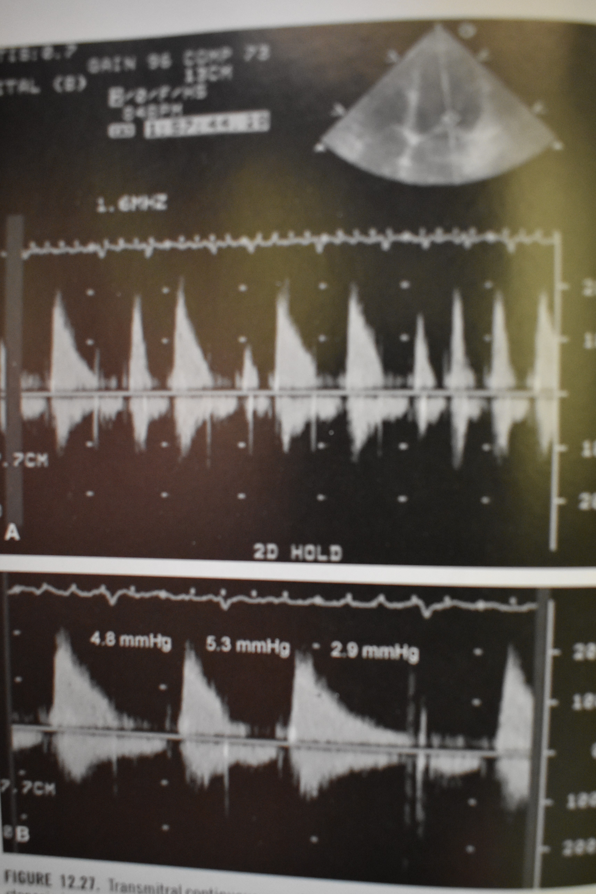
Atrial Fibrillation

Slide 17
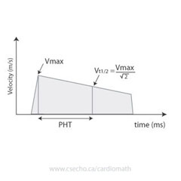
PRESSURE HALF TIME (PHT)
A measure of the rate of decay of mitral valve gradient.
Time in miliseconds at which the initial instantaneous pressure gradient declines to one half of its maximal value.
MVA = 220/PHT
PHT is affected by any factor that changes either LA Driving Pressure or LV Compliance and pressure. –LVH
-AR

Slide 18
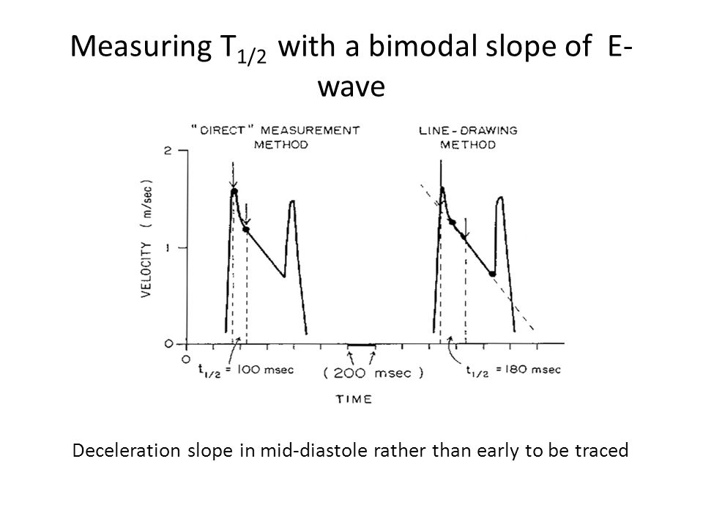
Ski Slope Appearance

Slide 19
Factors affecting PHT
LA pressure decline
ASD
Stiff LA: LA pressure drops rapidly and PHT is shortened
LV pressure rise
AR:LV fills from another source
Stiff LV:LV pressure may rise more rapidly
All of these result in overestimation of MVA

Slide 20
PHT after BMV
PHT is inaccurate soon after BMV
Usually increase in mean gradient is compensated by a decrease in compliance
Immediately after BMV there is discrepancy between decrease in mitral gradient and increase in net compliance

Slide 21
MVA by planimetry
Considered the reference measurement
PSAX View
Includes the open commisures

Slide 22
Gain setting should be just sufficient to visualize the contour of the Mitral orifice.
Excessive gain setting may cause underestimation of valve area.
3D echo imaging improves reproducibility and accuracy of planimetry measurement.

Slide 23
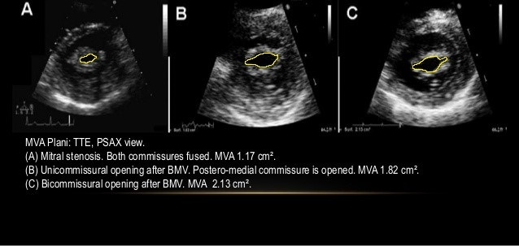

Slide 24
Advantages:
Direct measurement of MVA
Does not depend on flow conditions, cardiac chamber compliance or associated valvular lesions.
Disadvantages
Not feasible in poor acoustic window and severe valve calcification.

Slide 25
CONTINUITY EQUATION
Based on principle of Conservation Of Mass
Mitral Inflow Volume = Aortic Stroke volume

Slide 26
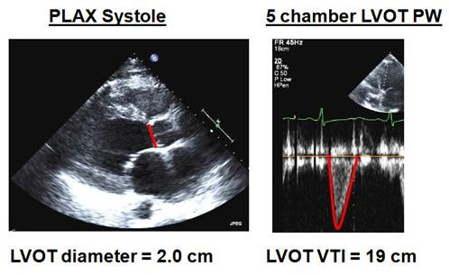
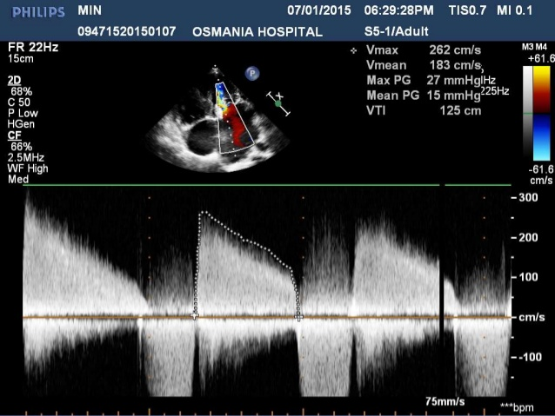

Slide 27
DISADVANTAGES
Needs multiple measurements and increased chance for errors
Cannot be used in AF or associated significant MR or AR.

Slide 28
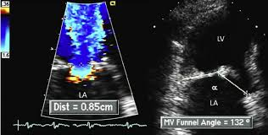
Proximal Isovelocity Surface Area (PISA)
When blood flows through a narrowed orifice it converges in a series of proximal isovelocity hemispheres or shells .
This flow convergence can be visualized proximal on a colour doppler on the atrial side of MV as mosaic colored signals.

Slide 29
Calculating MVA by PISA Method
Zoom the area of MV from the Apical 4 chamber view.
Use color flow imagig of mitralsteenosis jet and adjust aliasing velocity to 30-45 cm/sec
Freeze color flow images in a cine loo and identify an optimal frame to measure radius (r) of PISA in LA.
Determine the angle (α) between the two mitral leafletsat the Atrial surface and calculate MVA using the formula
A fixed angle of 100 Degrees can be used in MS patients.

Slide 30
PISA
Advantages
Can be used in presence of significant MR, AR and differing heart rhythms.
Not affected by LA or LV compliance
Disadvantages
Technically difficult

Slide 31
STRESS ECHO
Useful when patients symptoms are ot of proportion to seerity of MS.
Increase in flow across the MV can result in a significant increase in mean transmitral pressure gradient>15mmHg or PASP>60mmHg suggesting a hemodynamically significant M.S regardless of the resting gradient.
Semi-supine exercise echocardiography is now preferred to post exercise echocardiography. (30-60 seconds of leg lifts).
Dobutamine stress echo Mean Gradient> 18mmHg is considered severe MS.

Slide 32
Distance between tips of leaflets in PLAX and 4 Chamber view in diastole.
Value<0.8 cm predicts severe MS.
Value >1.1cm –Mild MS

Slide 33
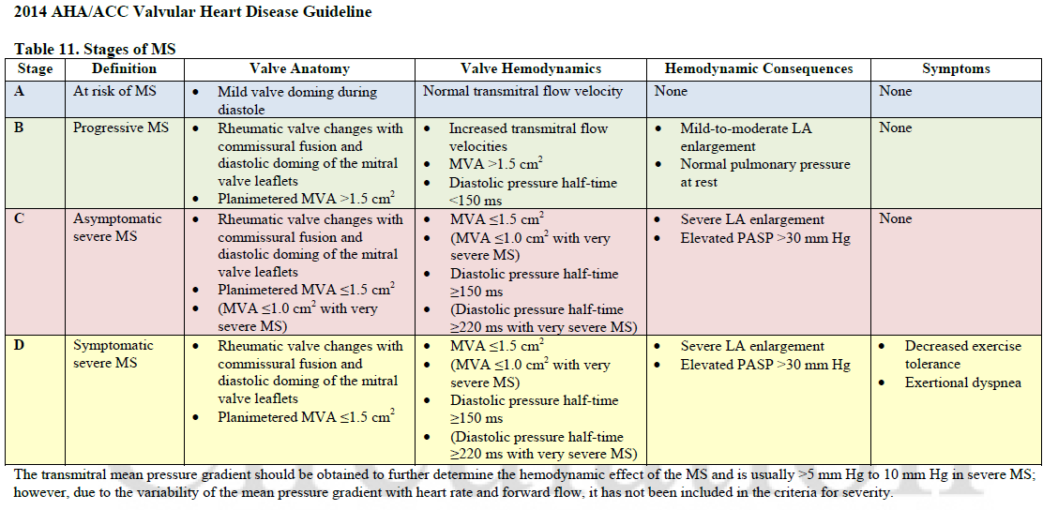

Slide 34
MS-SEVERITY (Previous)
Normal adult MVA – 4-6 cm2
 | MILD | MODERATE | SEVERE
VALVE AREA | >1.5 cm2 | 1.5-1.0 cm2 | <1.0
MEAN GRADIENT(mmHg) | <5 | 5-10 | >10
PHT | <90m/s | 90-150m/s | >150
PASP(mmHg) | <30 | 30-50 | >50

Slide 35
WILKINS SCORE

Slide 36
CORMIER SCORE
GROUP-1 | Pliable non-calcified AML and mild subvalvula disease(Thin chordae >/=10mm)
GROUP-2 | Pliable non calcified AML and severe subvalvular disease( Thickened chordae </= 10mm)
GROUP-3 | Calcification of MV of any extent as assessed by fluoroscopy whatever the state of subvalvular apparatus

Slide 37
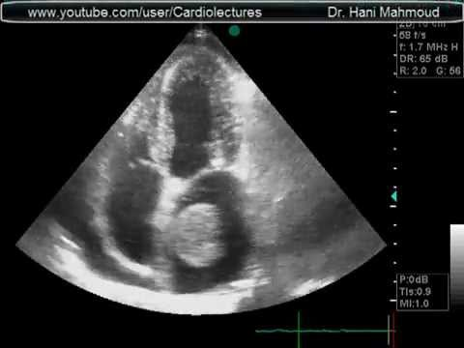
SECONDARY FEATURES OF MS
LA and LA Appendage dilation occurs.
Increased chance for thrombus formation due to stasis
Dilated RA RV and paradoxical septal motion may be seen due to pulmonary hypertension.

Slide 38
3D Echo
Higher accuracy than 2D echo.
Better information about commissural fusion and subvalvular involvement.

Slide 39
THANK YOU

